Slide 1

Advertising For The Right People
Prepared by :
Sami SHOKER

Slide 2
Motivation
Business Problem
Urgent need to cut off marketing budget due to Covid-19 pandemic.
Marketing to the Right People.
Work Plan
Analyzing the Characteristics for customers and non-customers who got quotes in our existing data.
Exploring the Relationship between the percentage of respondent who are customers and their characteristics in order to find the right people to advertise for.

Slide 3
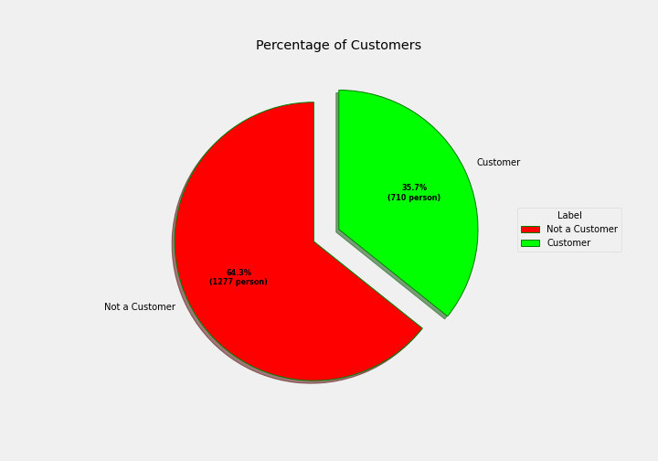
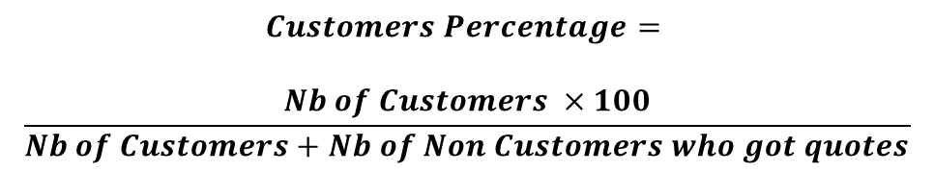
Customers Percentage
$$Customers Percentage=$$
$$\frac{Nb of Customers ×100}{Nb of Customers+Nb of Non Customers who got quotes}$$

Slide 4
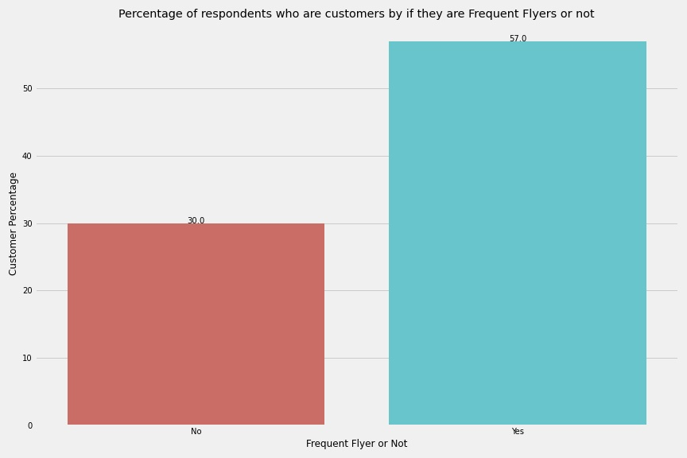
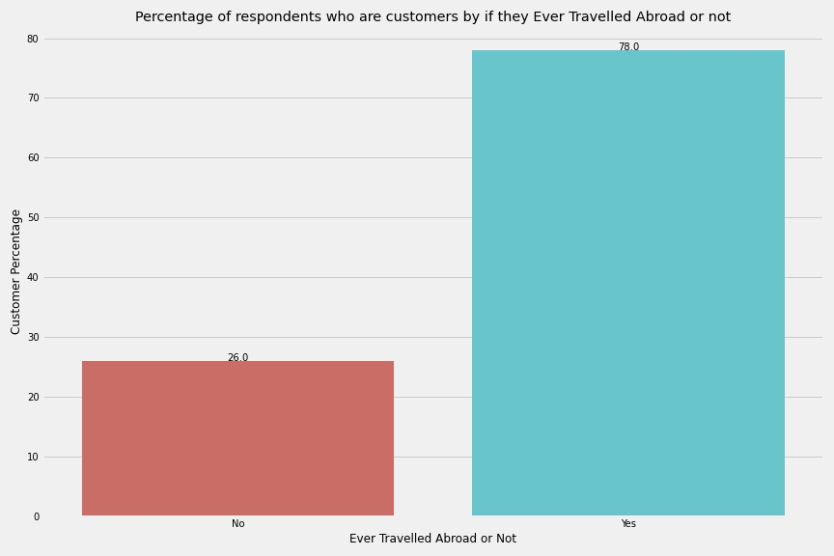
“Frequent Flyer” and “Ever Traveled Abroad”

Slide 5
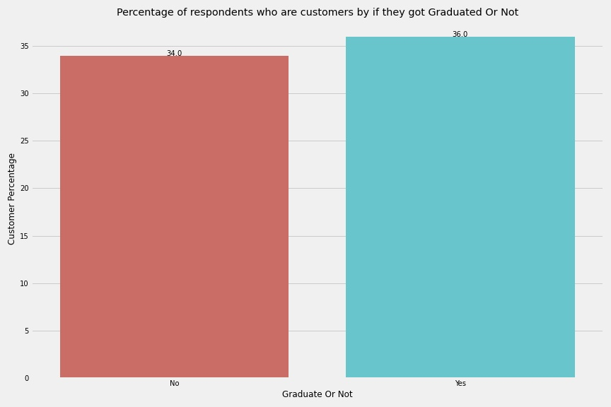
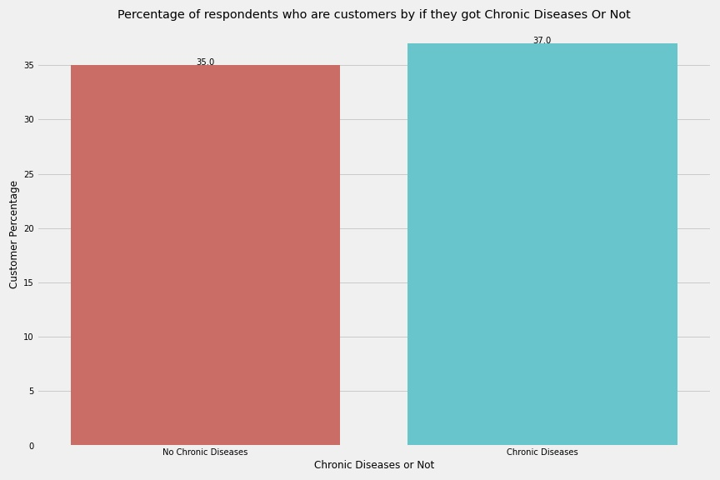
“Graduate or Not” and “Chronic Disease”

Slide 6
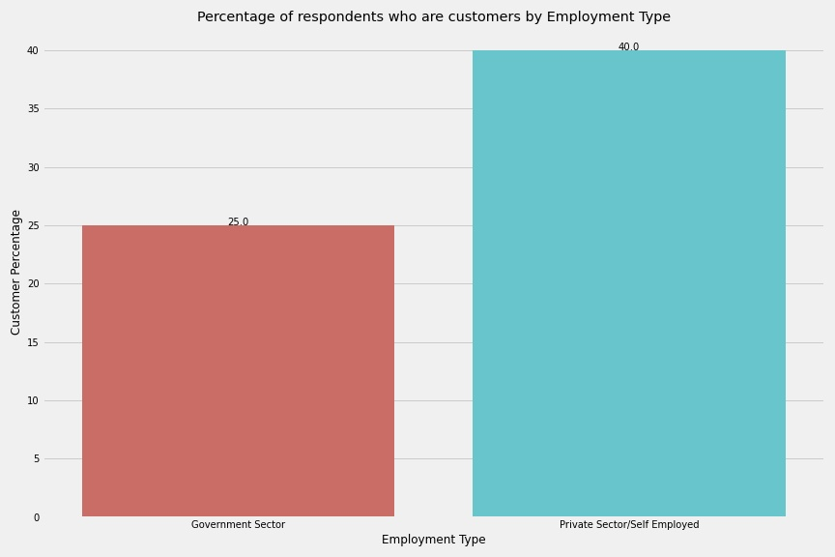
“Employment Type”

Slide 7
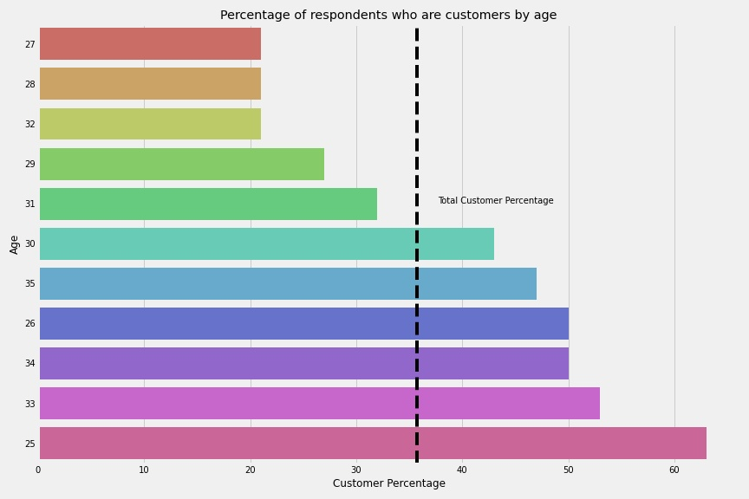
“Age”

Slide 8
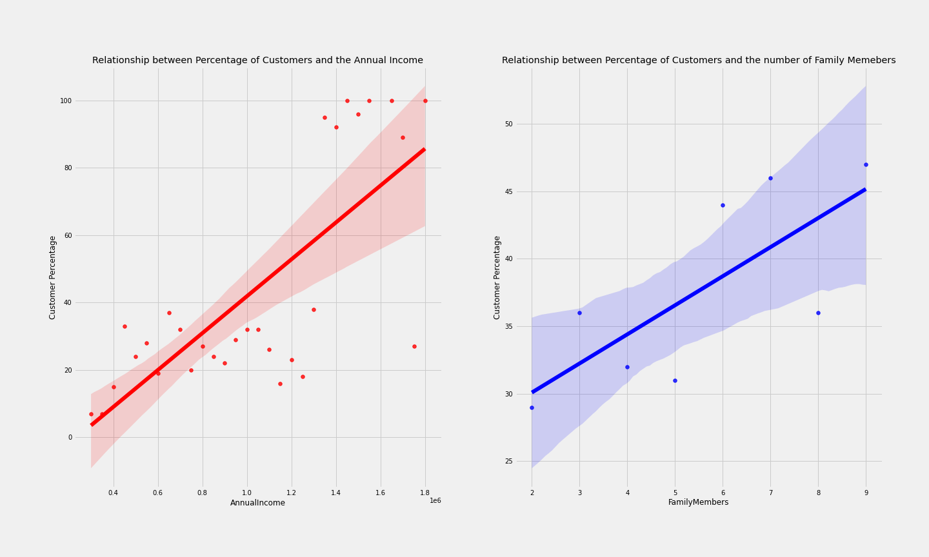
Annual Income and Family Members

Slide 9

Summary and Future Work
Summary
Target Frequent Flyer individuals and those who travels abroad.
Target Private Sector Employees.
Target People Having an age of 25,26,33,34.
Target People with high income and having big number of family members.
Next Step
Find the people with the characteristics highlighted in this work.
Run Social media ads for people having these characteristics.
Work with the data science team to build to build models that predict the chance of a person receiving quotes to become customer and the impact of influencing factors.

Slide 10
Thank You For your Attention

